Slide 1

DIGITAL MARKETING
GROUP - 9

Slide 2
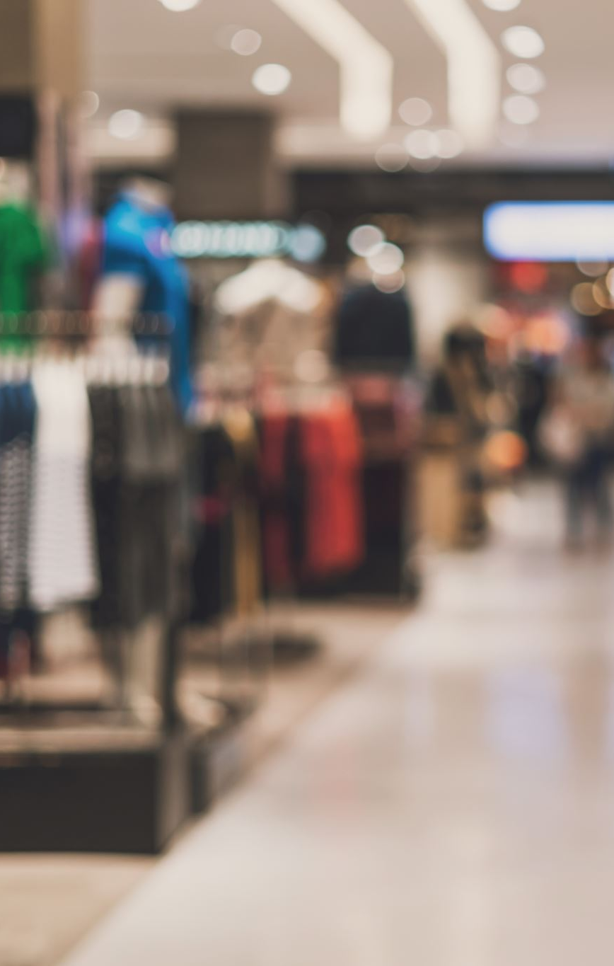
How successful has the Vanca been in the online retailing space in terms of conversions? Identify the reasons behind its poor conversion rate.
The Vanca's success in the online retailing space hasbeen mixed. The company aimed for conversion rates between 1-2% of daily visits but only achieved 0.5% from around 2,000 daily visits​​. This conversion rate is significantly lower than the average e-commerce conversion rate of 2-3%​
Reasons Behind Poor Conversion Rate :
Mismatched Expectations and Site Experience
Digital Marketing Shortcomings
Quality of Digital Engagement
Website and Transaction Quality
Customer Assistance and Engagement

Slide 3

What traffic-building strategies has The Vanca adopted? Is traffic building enough?
Traffic-Building Strategies Adopted by The Vanca
The Vanca has implemented a variety of traffic-building strategies to attract visitors to its online platform. These strategies include:
Search Engine Optimization (SEO): Optimizing content to rank higher in search engine results.
Search Engine Marketing (SEM): Using paid search ads to increase visibility on search engines.
Content Marketing: Creating and distributing valuable content through blogs to attract and engage customers.
Display Remarketing Ads: Tagging site visitors and showing them relevant ads on other websites to encourage them to return and make a purchase.
Affiliate Marketing: Partnering with affiliates who promote The Vanca’s products in exchange for a commission on sales.
Email Marketing: Sending flyers and promotional emails to subscribers twice a week to announce new launches and sales or discounts.
Social Media Marketing: Using platforms like Facebook, Twitter, and Instagram for brand awareness and engagement.
App-Based Promotional Campaigns: Running promotions through mobile apps to reach a wider audience.
Paid Ads: Utilizing paid advertisements on Google, Facebook, and Twitter to drive traffic to the site

Slide 4
While traffic-building strategies are essential for attracting visitors to The Vanca’s website, they are not sufficient on their own to ensure business success. High traffic does not necessarily translate to high conversion rates. The Vanca has faced challenges in converting this traffic into actual sales, as evidenced by their low conversion rates of around 0.5%, compared to the e-commerce average of 2-3%

Slide 5

How can The Vanca’ brand become a part of the consideration set of consumers?
Leveraging Innovative Initiatives:
The Vanca engaged official fashion bloggers and chat room experts to enhance customer experience and aid in the decision-making process.
The brand focused on site optimization by utilizing high-ranking keywords and purchasing keywords to improve website visibility.
Customer-Centric Approach:
The Vanca aimed to provide a seamless and unobtrusive customer journey, ensuring privacy and personalized interactions.
The company targeted a specific customer persona, "The Vanca Woman," between 18 and 40 years old, independent, socially active, and fashion-conscious.
Differentiation Strategies:
The Vanca positioned itself as "European fashion for the beautiful you," emphasizing its unique selling propositions like within-season drops and rapid innovation.
The company adopted a differentiated channel strategy, including shop-in-shop branded stores within retail setups like Shoppers Stop and Lifestyle.

Slide 6
Digital Marketing and Brand Building:
The company allocated a significant portion of its marketing budget to digital channels, focusing on platforms like Facebook, Instagram, and YouTube.
The long-term objective was to increase digital marketing spend further and strengthen brand presence to drive sales through the company's own channel.
Focus on Value Chain and Market Agility:
The Vanca's rapid growth was supported by investments in information technology for the entire value chain and the ability to respond effectively to market demands.
The brand's strength lay in delivering "drops" within seasons and staying abreast of international fashion trends to address customer needs promptly.
Offline Retailing Insights:
The company learned valuable lessons from offline retailing, such as the importance of timing discounts and the benefits of offline stores despite online shopping conveniences.
The Vanca's offline presence in shop-in-shop branded stores provided a solution to the limitations of the online shopping experience.
Future Strategies:
The company planned to enhance brand visibility, focus on growth-oriented marketing, and increase digital marketing efforts to drive sales through its own channel.
The goal was to maintain a strong brand presence and expand the customer base by targeting specific consumer segments effectively.

Slide 7
If you have to join Vanca as the digital marketing manager, What should be your key focus areas ? How are you planning to achieve them ?
Key Focus Areas
Improving Website Usability and User Experience
Enhancing Digital Marketing Strategies
Optimizing Product Presentation and Inventory Management
Leveraging Data Analytics for Insights
Strengthening Customer Engagement and Support

Slide 8
Improving Website Usability and User Experience
Site Speed Optimization
Mobile Optimization
User-Friendly Navigation
Checkout Process
Enhancing Digital Marketing Strategies
Search Engine Optimization (SEO)
Pay-Per-Click (PPC) Campaigns
Email Marketing
Social Media Marketing
Optimizing Product Presentation and Inventory Management
Product Descriptions and Images.
Inventory Management

Slide 9
Leveraging Data Analytics for Insights
Customer Behavior Analysis
Conversion Rate Optimization (CRO)
Strengthening Customer Engagement and Support
Live Chat and Customer Support
Loyalty Programs
Customer Feedback

